Slide 1

Develop microservices with Spring Boot
A.A. 2025/2026
Service-oriented Software Engineering
Gianluca Filippone
gianluca.filippone@gssi.it

Slide 2
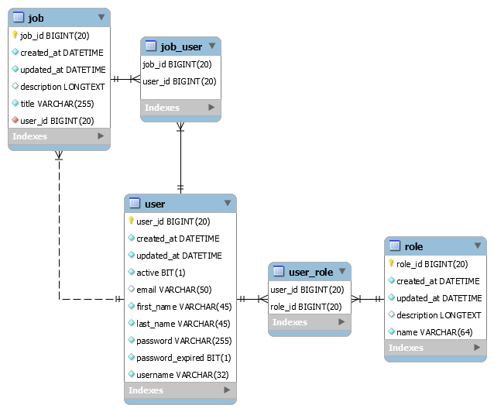
Monolithic application
OpenJob
Platform that allows people to publish or apply for job offers

Slide 3
Build the application through Spring Boot
Ingredients
Java Development Kit (25 or later)
Apache Maven
Spring Tools 4
https://spring.io/tools

Slide 4
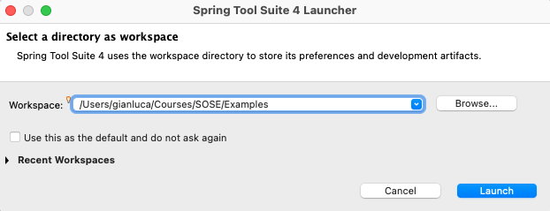
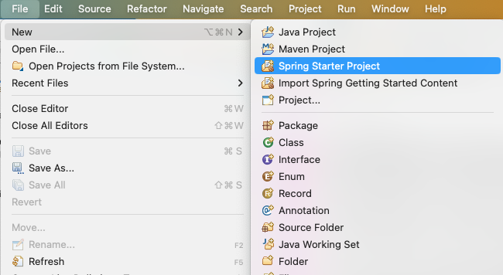
1: Initialize the project
Open Spring Tools and create a new workspace
File -> new -> Spring Starter Project

Slide 5
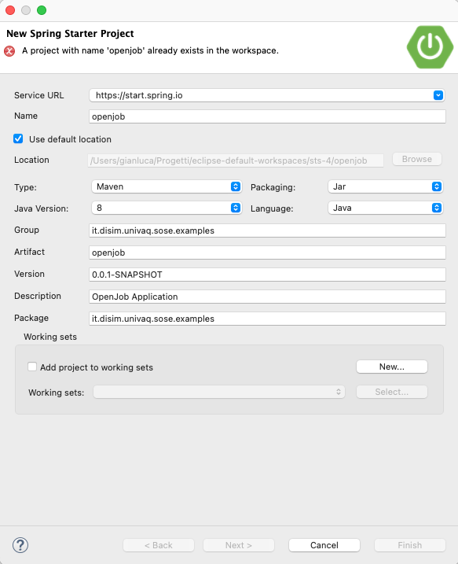
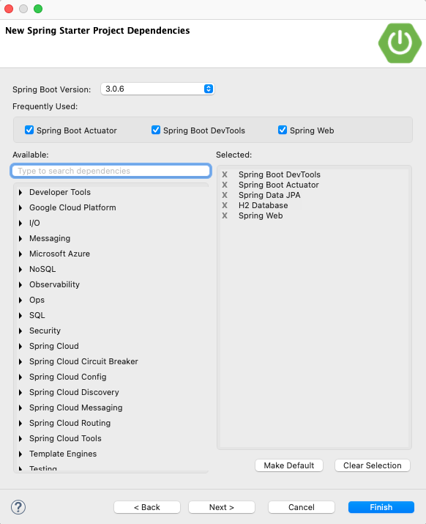
1: Initialize the project
Follow the wizard

Slide 6
1: Initialize the project
Selected dependencies
Spring Boot DevTools
Provides fast application restarts, LiveReload, and configurations for enhanced development experience
Spring Boot Actuator
Supports built in (or custom) endpoints to monitor and manage the application (e.g., health, metrics, sessions, etc.)
Spring Data JPA
Persist data with Java Persistence API using Spring Data and Hibernate
H2 Database
Fast, zero-configuration in-memory database
Spring Web
Build web, including RESTful, applications using Spring MVC. Uses Apache Tomcat as the default embedded container.

Slide 7
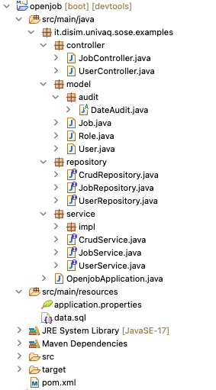
2: Implement the application
The result we want to obtain
Implement controllers, services etc.
https://github.com/gianlucafilippone/springboot-microservices-development/mobolithic-application/openjob

Slide 8



3: Result
Available Endpoints
/actuator
[GET] http://localhost:9092/actuator/health
[GET] http://localhost:9092/actuator/info
/user
[GET, POST, PUT] http://localhost:9092/user
[GET, DELETE] http://localhost:9092/user/id/<ID>
[GET] http://localhost:9092/user/username/<USERNAME>
/job
[GET, POST, PUT] http://localhost:9092/job
[GET, DELETE] http://localhost:9092/job/<ID>
[GET] http://localhost:9092/job/apply/<USERNAME>/<ID>
/job
/user
Openjob (9092)
/actuator
openjob H2 database
Spring boot
Spring data

Slide 9
Migrate the application to microservices

Slide 10
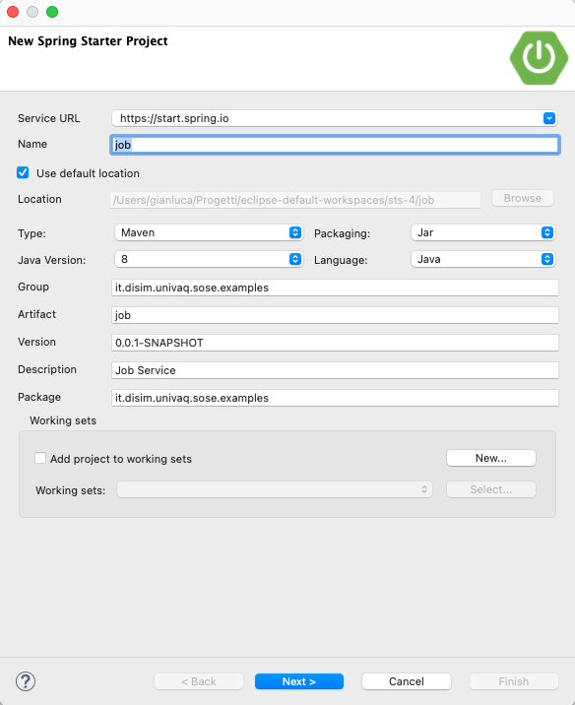
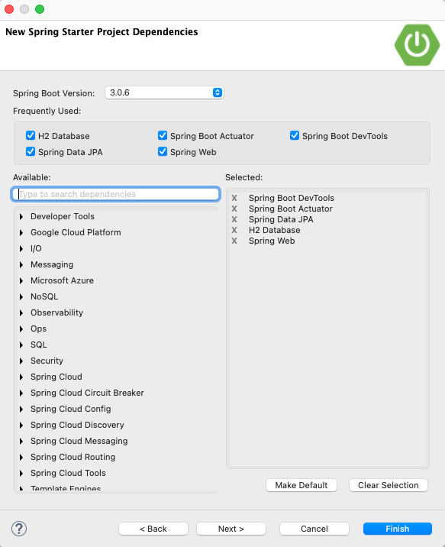
Realize User and Job microservices
Initialize two applications using the wizard: user and job
Same dependencies as the monolith (for now)

Slide 11
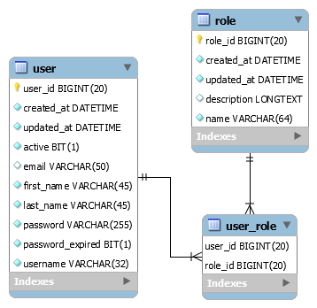
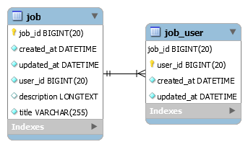
Decomposed database
Database Schema(s)
Job Service schema
User Service schema

Slide 12
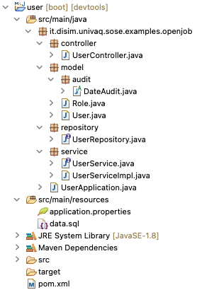
User service
The result we want to obtain:
Implement controllers, services etc.
Available Endpoints
/actuator
[GET] http://localhost:9044/actuator/health
[GET] http://localhost:9044/actuator/info
/user
[GET, POST, PUT] http://localhost:9044/user
[GET, DELETE] http://localhost:9044/user/id/<ID>
[GET] http://localhost:9044/user/username/<USERNAME>

Slide 13
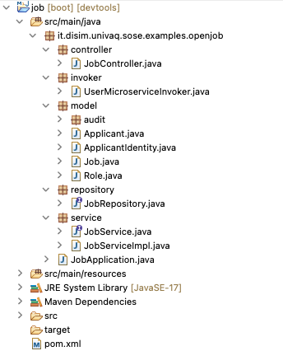
Job Service
The result we want to obtain:
Implement controllers, services etc.
Available Endpoints
/actuator
[GET] http://localhost:9055/actuator/health
[GET] http://localhost:9055/actuator/info
/job
[GET, POST, PUT] http://localhost:9055/job
[GET, DELETE] http://localhost:9055/job/<ID>
[GET] http://localhost:9055/job/apply/<USERNAME>/<ID>

Slide 14
Result
/user
/job
user (9044)
[GET] /user/username/{username}
job (9055)
/actuator
/actuator
user H2 database
job H2 database
Spring boot
Spring data

Slide 15
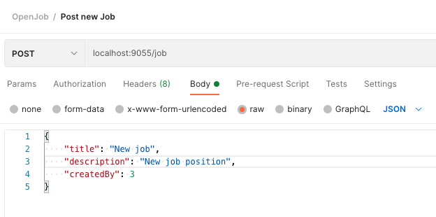
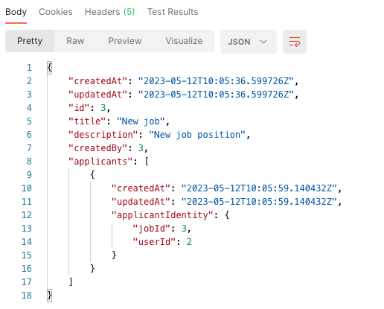
Test the application
Run both (micro)services
Get list of users and jobs
[GET] http://localhost:9044/user
[GET] http://localhosst:9055/job
Post a new job offer
[POST] http://localhost:9055/job
Apply for a job
[GET] http://localhost:9055/job/apply/<USERNAME>/<JOB_ID>
Get the details of the applied job
[GET] http://localhosst:9055/job/<JOB_ID>

Slide 16
Adding an API Gateway

Slide 17

Architecture
openjob-gateway (9000)
/user
/job
user (9044)
[GET] /user/username/{username}
job (9055)
/actuator
/actuator
Spring boot
user H2 database
job H2 database
Spring data
Spring cloud

Slide 18
Spring Cloud Gateway
Spring Cloud
Spring Cloud is an umbrella containing different projects
Provides tools for developers to quickly build some of the common patterns in distributed systems
Distributed configuration, service discovery, routing, load balancing, …
Spring Cloud Gateway
Library for building an API Gateway on top of Spring WebFlux
Out-of-the-box routing mechanisms
Main configuration components:
Route: consists of an ID, a destination URI, a set of predicates and filters
Predicates: match URI, headers or parameters from the HTTP request
Filters: allow to modify requests and responses

Slide 19
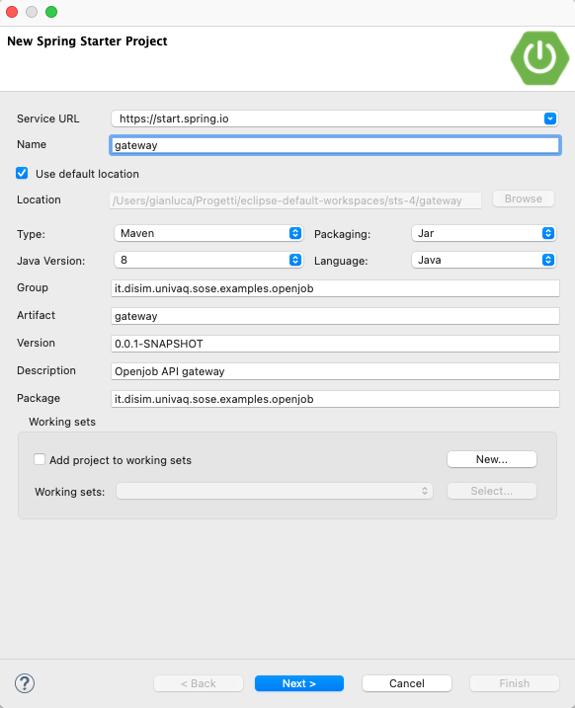
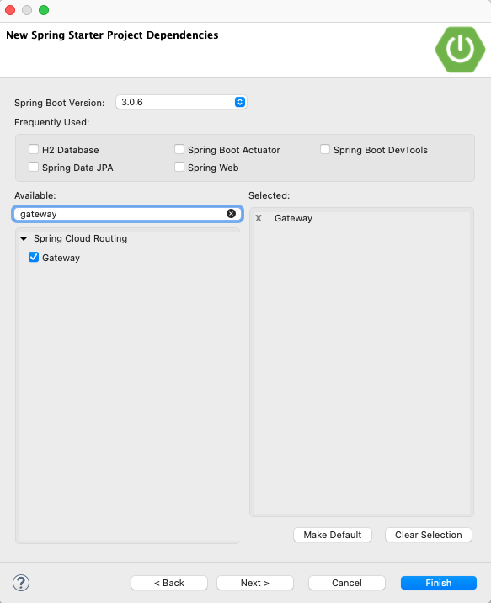
Init a Spring Cloud Gateway project
From the Spring Initializer or from Spring Tools
Select Gateway dependency
q

Slide 20
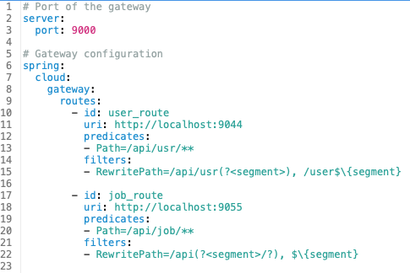
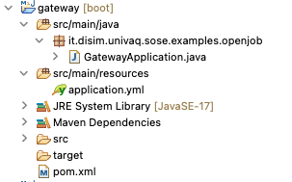
Configuring the gateway
Routes we want to expose to clients:
http://localhost:9000/api/usr for User service
http://localhost:9000/api/job for Job service

Slide 21
Decentralize microservice configuration

Slide 22
Maintaining microservices configuration
Maintain and manage the configuration of microservices is complex
Hundreds of services with different configurations
Usually done through configuration files
Config updates need restart
Centralized mechanism for maintain configuration is convenient
Store the properties of all the microservices
A centralized server receives the changes and updates properties
Externalized configuration
Spring Cloud Config provides this support

Slide 23
Spring Cloud Config
Provides support for the centralized configuration
Server side (spring-cloud-config-server)
Client side (spring-cloud-config-client)
At application startup
Microservice asks the configuration properties
config-service reads the configuration files
From a local directory, Git, or a database
Configuration properties are returned to the microservice
When configuration is updated
Developers update the configuration files
The update is notified to the microservice
Through /actuator/refresh endpoint
Developer
Configuration files
4
2
config-server
5
1
3
Microservice
(config-client)

Slide 24

Upgrade our Openjob system
Steps
Create a repository to store the properties files
Create the Spring Cloud Config server
Upgrade our microservices
Expected Result
/api/*
/actuator
openjob-gateway (9000)
openjob-config-server (8888)
/user
/job
/actuator
user (9044)
job (9055)
/actuator

Slide 25

Property file repository
Create a new git repository
git init openjob-properties-repository
(Optional) Import repository into Spring Tools
File -> Import -> Git -> Projects from Git -> Existing local repository
Click on "add" and select the git project folder
Select "import as general project"
Move configuration files into the repository, e.g.
user/src/main/resources/application.properties >>> user-microservice-dev.properties
job/src/main/resources/application.properties >>> job-microservice-dev.properties
gateway/src/main/resources/application.yml >>> api-gateway-dev.yaml
You can commit the files into the repository to version the configuration
git add .
git commit -m 'add configuration files'
Mind these names!

Slide 26

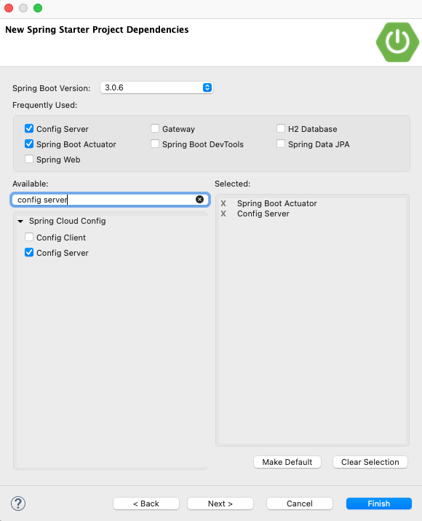
Spring Cloud Config server
Init a new Spring Boot project
Select Config Server as dependency

Slide 27
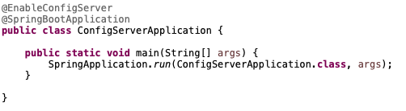
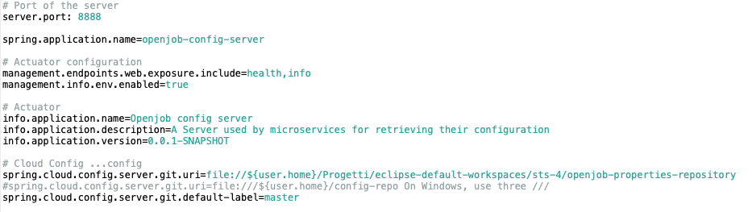
Spring Cloud Config server
Edit Application class
Add @EnableConfigServer annotation
Add properties file
Port of the server
Actuator service configuration
Spring cloud server configuration

Slide 28
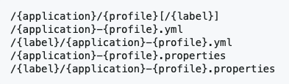
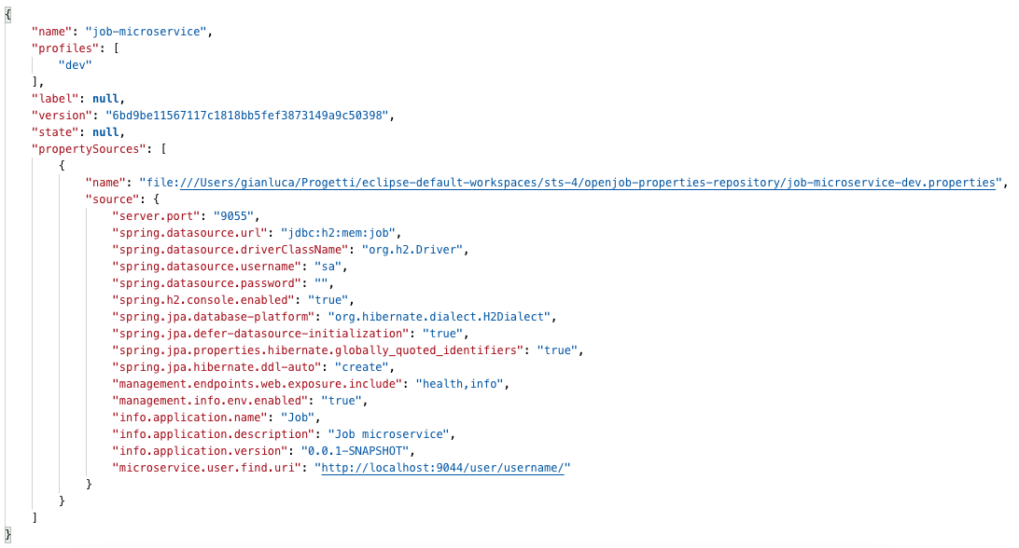
Spring Cloud Config server
Test exposed endpoints
localhost:8888/user-microservice/dev
localhost:8888/job-microservice/dev
localhost:8888/api-gateway/dev

Slide 29

Upgrade microservices and API Gateway
Update pom.xml file (see slide notes)
Add dependency management for spring cloud
Add spring-cloud-config-client dependency
Create a new application.properties file
Set the following properties
spring.application.name
spring.profiles.active
spring.config.import
Run and test
Run the microservice, change the port on the configuration file, stop and re-run the microservice
Configuration server URI
Notes:
<dependencyManagement>
<dependencies>
<dependency>
<groupId>org.springframework.cloud</groupId>
<artifactId>spring-cloud-dependencies</artifactId>
<version>${spring-cloud.version}</version>
<type>pom</type>
<scope>import</scope>
</dependency>
</dependencies>
</dependencyManagement>
<spring-cloud.version>2022.0.2</spring-cloud.version>
<dependency>
<groupId>org.springframework.cloud</groupId>
<artifactId>spring-cloud-starter-config</artifactId>
</dependency>

Slide 30
Update properties at runtime
Let's do a test
Change the user-microservice configuration
Set the service port to, e.g., 9045
Restart user-service
(We need to restart for updating its port)
Send a GET request to job microservice
[GET] http://localhost:9055/job/apply/applicant/2
We should get an error
Job service tries to invoke User service, but it is running on a different port
We should update the configuration of Job service
We need to restart the service for this?

Slide 31

Refresh and @RefreshScope
Using @RefreshScope annotation on a bean we can force it to refresh its configuration
E.g., the @Value annotated properties
Add @RefreshScope to UserMicroserviceInvoker class
Add refresh to the actuator's exposed endopoints
Into job-microservice-dev.properties
Invoke the actuator/refresh endpoint to update the configuration
Send an empty POST request to localhost:9055/actuator/refresh
Try again to call without restarting

Slide 32
Running multiple instances

Slide 33
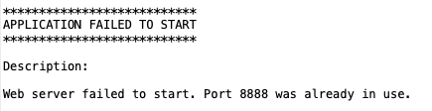
Running multiple instances
If we try to run each service more than once, we'll get an error
(If on the same host)
The port is already in use
Containerization solves this problem
Each service runs on its container, with port mapped
If we do not want this, we should provide different properties for each instance
Does not sound good
We can override properties through command-line arguments
Command line arguments take precedence over file-based property sources
E.g., mvn spring-boot:run -Dspring-boot.run.arguments="--server.port=9066"

Slide 34
Load balancing

Slide 35
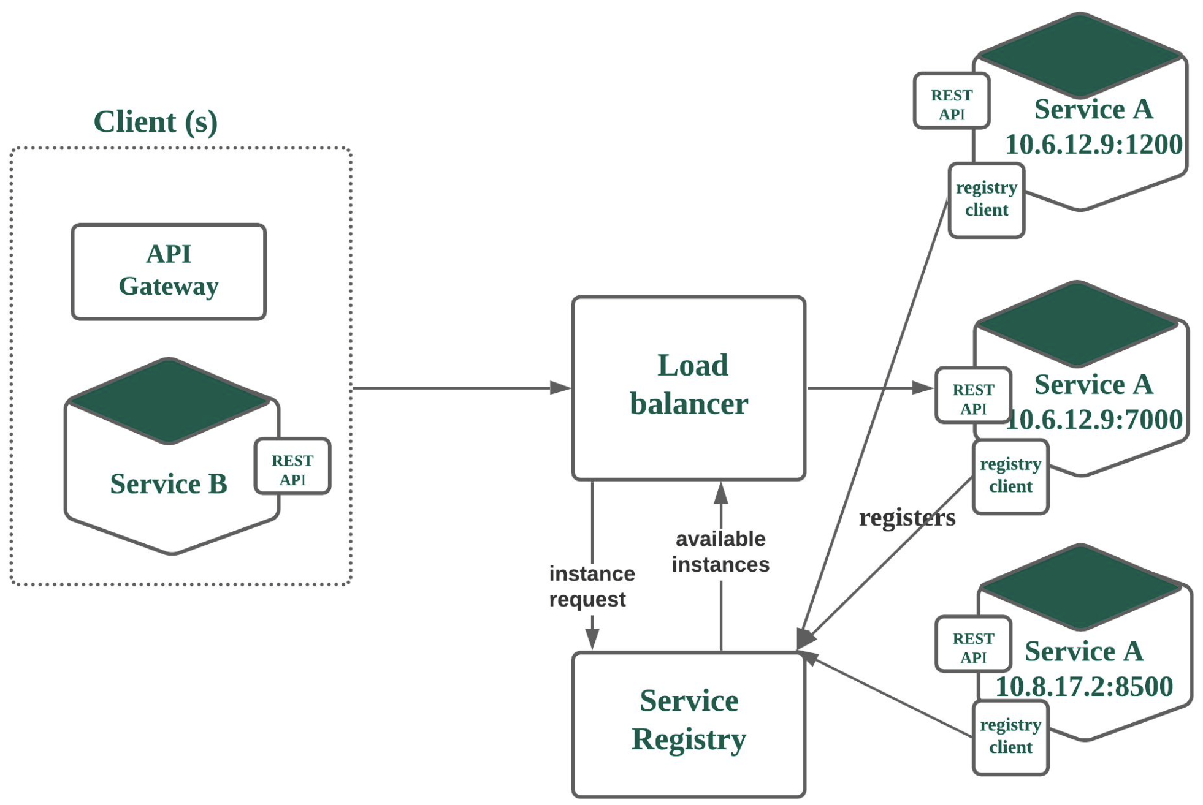
Load balancing microservices

Slide 36
Spring Cloud Netflix
Spring Cloud Netflix provides tools to realize load balancing by integrating Netflix components
Service discovery (Eureka)
Netflix Eureka has served Netflix for years
Previous version included Ribbon and Zuul for load balancing, Hystrix for fault tolerance
Eureka client
Eureka client services register to the server and discover client instances
Send heartbeats to the service
Eureka server
Provides a home page with a UI and HTTP API endpoints for the normal Eureka functionality

Slide 37
Upgrade our Openjob system
Steps
Create a discovery server
Update services to work as eureka clients
Update the gateway to work as a load balancer
/api/*
openjob-gateway (9000)
discovery-server
(8761)
openjob-config-server (8888)
user (9044)
job (9055)
job (9055)
job (9055)
job (9055)

Slide 38
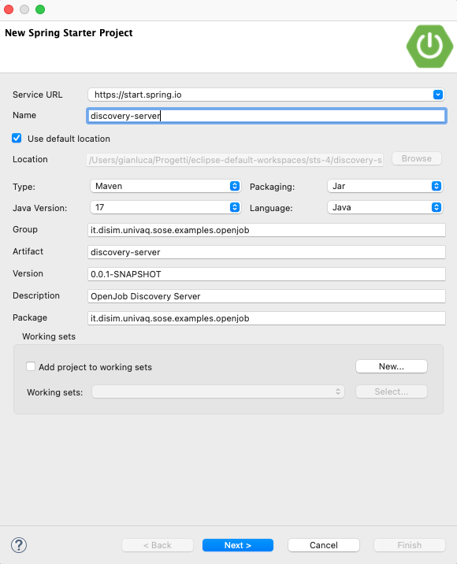
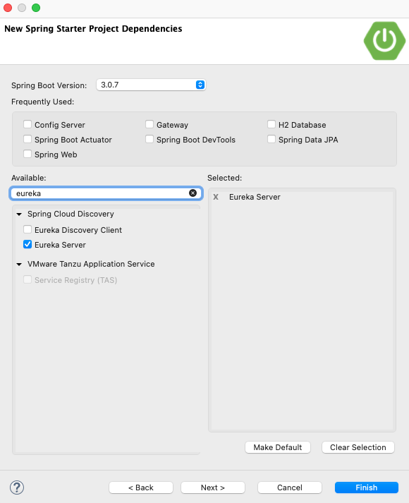
Eureka Server

Slide 39
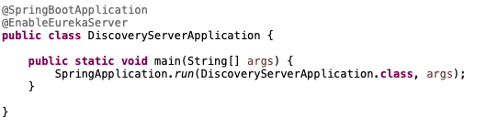
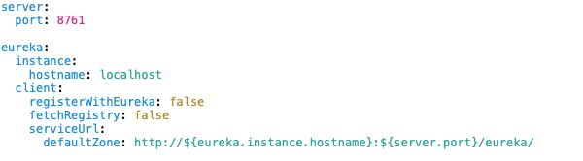
Eureka Server
Edit Application class
Add @EnableEurekaServer annotation
We will run the server in the standalone mode
I.e., only one Eureka server instance in our system
Edit application.yml file to add configuration
That's it
Browse http://localhost:8761/ to see the Eureka dashboard

Slide 40

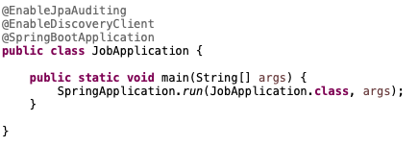
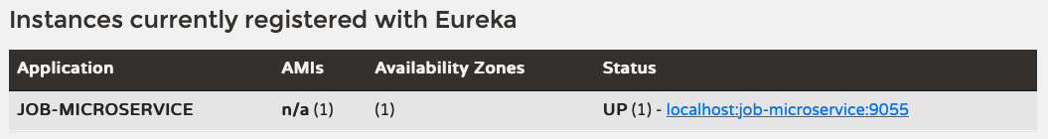
Update services
Job service
Add spring-cloud-starter-netflix-eureka-client dependency to pom.xml
Add @EnableDiscoveryClient annotation to the Application class
Run and browse again http://localhost:8761/

Slide 41
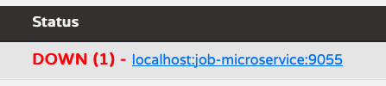
Play with Eureka service
Eureka server by default expects that clients send heartbeats every 30 seconds
If clients have a different interval, a message is shown
To align clients to this interval, a configuration property is required
eureka.instance.lease-renewal-interval-in-seconds=30
Clients unregister thmeselves at shutdown
Let's test a network problem:
Add the eureka.client.should-unregister-on-shutdown=false property to the client service
Stop the service

Slide 42
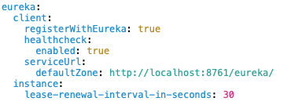
Update the gateway
Same steps as before:
Add spring-cloud-starter-netflix-eureka-client dependency to pom.xml
Add @EnableDiscoveryClient annotation to the Application class
Add configuration properties
Edit application.yml

Slide 43
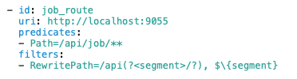
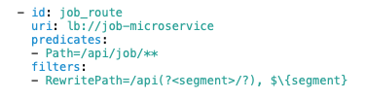
Load balance instances
Update the gateway configuration
Instruct the gateway to lookup services via the Eureka server
Test the load balancer
Start (or POST to http://localhost:9000/actuator/refresh) the gateway
Send a request to http://localhost:9000/job to test
job-microservice must be defined through the spring.application.name property in its service properties!!!

Slide 44
Client-side load balancing

Slide 45
Client-side load balancer
When running multiple instances of the User microservice, load balancing is needed to route requests from Job microservice to User
First solution (1)
Send requests through the API Gateway and its load balancer
Realize a centralized approach
More decentralized solution (2)
Use a client-side load balancer
/api/*
openjob-gateway (9000)
discovery-server
(8761)
1
user (9044)
job (9055)
user (9044)
job (9055)
user (9044)
job (9055)
user (9044)
job (9055)
2

Slide 46
Spring Cloud OpenFeign
Spring Cloud supports Feign, a declarative service client
Feign creates a dynamic implementation of an interface decorated with JAX-RS annotations (e.g., @RequestMapping, etc.)
Integrates discovery, load balancing, circuit breaking, etc. from Spring Cloud
Integrate OpenFeign
Add spring-cloud-starter-openfeign pom dependency
Add @EnableFeignClients annotation to Application class
Create a dynamic client
Create an interface and annotate it with @FeignClient annotation
Annotate methods with @RequestMapping

Slide 47

Update Job microservice
Job microservice has an invoker class to call User microservice
Update and use a dynamic Feign client
Create a new package and a new interface
Annotate the interface with @FeignClient
Name of the Feign client, url of the service to call
Add a new method
Annotate with @RequestMapping as in JAX-RS services
Update the controller class to use the Feign client
Change the autowired service

Slide 48

Enable load balancing
In the current implementation we set the URL of the invoked service
@FeignClient(name="userMicroserviceFeignClient", url="${microservice.user.find.uri}")
Feign supports Eureka service discovery
Update the @FeignClient annotation to use the service discovery
Update the @RequestMapping annotation
Application name of the user service
Request path for the API call

Slide 49
Consistency issues with the databases
We are running the services with an H2 in-memory DB.
When running multiple instances, each instance will own its data
We need to switch to a standalone DB
Update User and Job microservices:
Remove the H2 pom dependency, add mysql-connector-j
Update properties file
Remove the H2-related properties
Update the data.sql to comply with the SQL syntax (e.g., use ` instead of ")

Slide 50
Deploying microservices on Docker

Slide 51
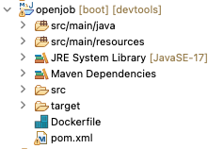
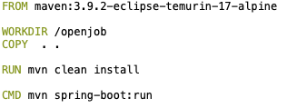
Create an image
Let's do it with the Openjob monolith
Create a Dockerfile on the root folder of the project
Run the command docker build -t openjob . from terminal
Check the created image with docker images command (or from Docker Desktop)
Base image for next instructions
It will be pulled from a public repo
(use "...temurin-25-…"!)
Create the /openjob folder, move into it and copy the content of the project inside
Compile the project
Specify the programs/commands to execute while initializing a container from the image
(Run the openjob application)

Slide 52
Run the container
Run the command docker run --name openjob-app -p 9090:9092 -d openjob
Run docker container ls to check the list of running containers
Name of the container to be created
Name of the image
Port mapping:
Host port 9090 mapped to container port 9092
Run in dethatched mode

Slide 53
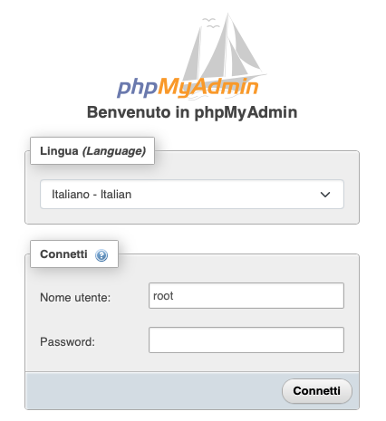
Dockerize the Mysql database
Create a network to let containers communicate
docker network create openjob-network
Pull the mysql Docker image
docker pull mysql:latest
Run the container
docker run -d --name openjob-mysql --network openjob-network
-v mysql-data:/var/lib/mysql
-e MYSQL_ROOT_PASSWORD=root mysql:latest
Run a container with Phpmyadmin (not required, just to check)
docker pull phpmyadmin:latest
docker run --name openjob-phpmyadmin –d
--network openjob-network
--link openjob-mysql:db -p 8081:80 phpmyadmin:latest
Check at http://localhost:8081

Slide 54
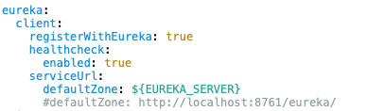

Before dockerizing services…
Let's recall that
We are using a configuration server
With configuration files stored in a git repository…
Push files to a remote git repository (so it can be accessible from everywhere)
I created my own, e.g., https://github.com/gianlucafilippone/openjob-properties-repository
When put on containers, service addresses should not be hard-coded
We hard-coded the configuration server address
…the Eureka server
…the database address and parameters
Update properties files

Slide 55
Regarding remote repository
In the development approach, we can also use local repos to update services properties.
It's more convenient, because the ".yaml" and ".properties" files in the folder differ from step to step
To effectively use the remote repo, it's possible to setup different branches to have different configuration repos to use

Slide 56
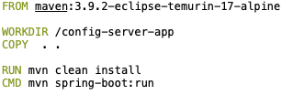
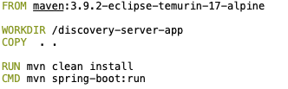
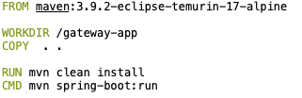
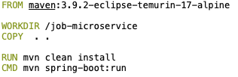
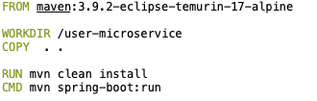
Create Images
Create a Dockerfile for each maven project (using the right Java version, i.e. 25 "…temurin-25...")
Run the command docker build -t <IMAGE-NAME> . for each project
Check the images by running docker image list

Slide 57
Run containers
Containers can be created and started with docker run <IMAGE-NAME>
We must specify the environment variables to instantiate configuration parameters
Since running on the same network, containers can communicate through their name (instead of, e.g., localhost).
Each container has its own IP address
Example
docker run --name user-microservice --network openjob-network -dp 9044:9044
-e CONFIG_SERVER_HOST=config-server
-e CONFIG_SERVER_PORT=8888
-e EUREKA_SERVER=http://discovery-server:8761/eureka/
-e MYSQL_HOST=openjob-mysql:3306
-e MYSQL_DB=user_db
-e MYSQL_USER=root
-e MYSQL_PASSWORD=root user-microservice

Slide 58
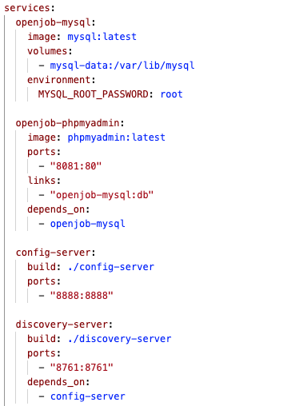
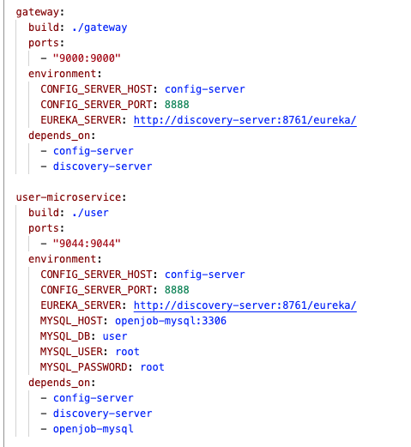
Docker compose
When applications are made as a composition of many services, we can leverage docker compose instead of manually create images and run containers

Slide 59
Running docker compose
Run the command docker compose -p openjob up -d
Containers will be created and started
Make your application resilient!
Dependencies ensure that containers are started in sequence
Does not ensure that services are ready
Use Spring Retry to get configuration and avoid failures
Add spring-retry and spring-boot-starter-aop dependencies
Scale services dynamically
Use docker compose up --scale <SERVICE-NAME>=<NUMBER> -d
Update the docker-compose.yml file to make the port selection dynamic
Use "expose" to randomly map host ports to the exposed container port
Select a range of host ports to be mapped to the exposed container port (e.g., "9044-9049:9044")

Slide 60
Beyond Basic Dockerization - Full-Stack & Observability
Until last slide: The system ran core backend microservices via Docker Compose.
New Architectural Challenges & Evolutionary Steps:
User Experience & Interactivity: Added a reactive Single-Page Application (SPA) as a frontend.
Domain Business Intelligence: Clear separation between Business/Domain metrics and Infrastructure metrics.
Data Integrity & Persistence: Upgrade MySQL schema from VARCHAR(255) to TEXT (4096 chars) for rich job descriptions.
Automated Load Testing: Introduce Python Locust to simulate realistic multi-user concurrent traffic.
Enterprise Full-Stack Telemetry: Real-time Prometheus TSDB scraping & Grafana dashboards (JVM, HikariCP, Gateway HTTP).

Slide 61
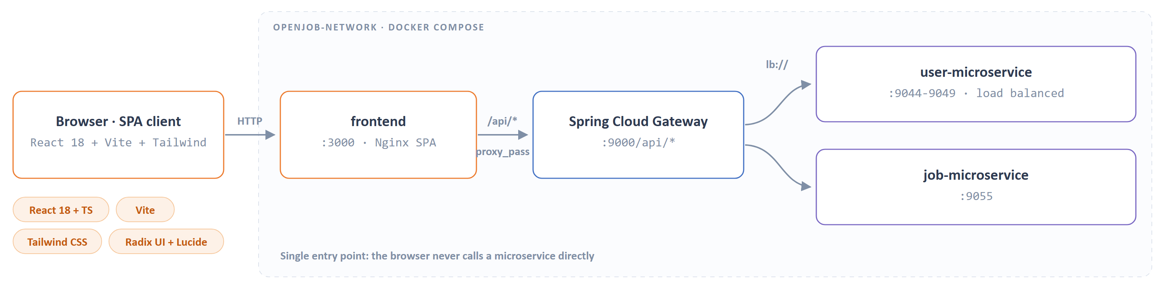
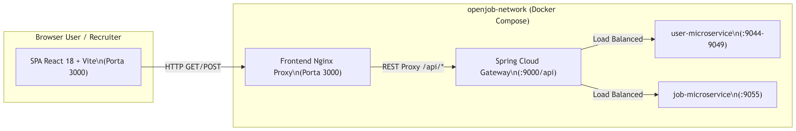
Modern SPA Frontend Re-Architecture (React + Vite + Tailwind)
State-of-the-Art Frontend Tech Stack:
Core Logic: React 18 with strict TypeScript typing across all entities (User, Job, ApplicationRow).
Build Engine: Vite with ultra-fast Hot Module Replacement (HMR) and optimized static production builds.
Design System: Tailwind CSS + Radix UI Primitives + Lucide Icons for premium enterprise-grade aesthetics.
Decoupled & Secure API Gateway Integration:
All client-side API requests are cleanly routed via Spring Cloud Gateway (:9000/api/*).
Gateway handles downstream load balancing to User (:9044+) and Job (:9055) microservice instances.

Slide 62
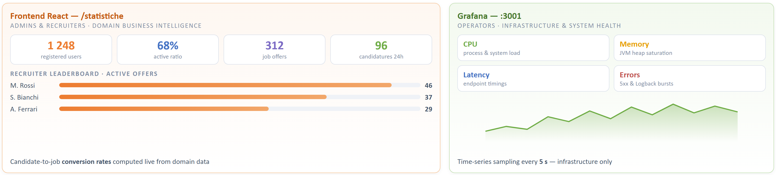
Domain Business Intelligence Dashboard (/statistiche)
Separation of Concerns: Domain vs. Infrastructure Metrics
Grafana is dedicated exclusively to Infrastructure & System Health (CPU, Memory, Network Latency).
Frontend React (/statistiche) hosts the dedicated Domain Business Intelligence dashboard for Admins and Recruiters.
Key Performance Indicators (KPIs) & Live Domain Metrics:
Total Registered Users & Active User ratios.
Published Job Offers & Total Candidatures submitted in the last 24 hours.
Candidate-to-Job conversion rates and Recruiter Leaderboards (Top recruiters ranked by active offers).

Slide 63
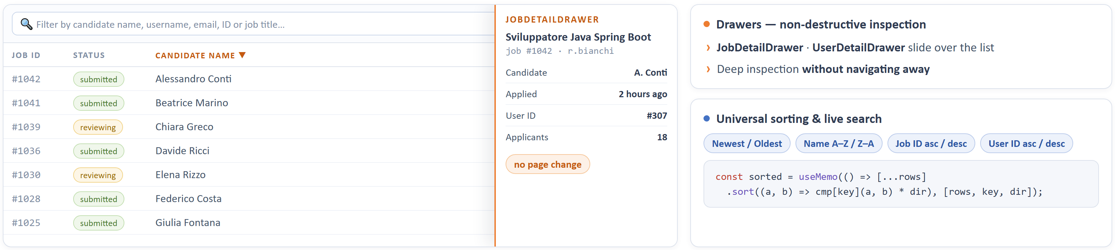
Dynamic UX - Drawers, Multi-Criteria Sorting & Live Search
Non-Destructive Inspection via Drawers (Sheet/Drawer UX):
Sliding side panels (JobDetailDrawer, UserDetailDrawer) allow deep inspection of candidates without navigating away.
Upgrading All Frontend Lists & Tables (DataTable):
Universal Multi-Criteria Sorting: Client-side useMemo sorting implemented across all tables.
Sort by: Chronological order (Newest/Oldest), Candidate Name (A-Z/Z-A), Job ID, and User ID (Asc/Desc).
Instant Textual Search Bars: Filter live lists by candidate name, username, email, ID, or job title.

Slide 64

Frontend Containerization & Nginx Reverse Proxy
Multi-Stage Docker Build Optimization (frontend/Dockerfile):
Stage 1 (Build): node:22-alpine installs dependencies (npm ci) and compiles the production static bundle.
Stage 2 (Runtime): Ultra-lightweight nginx:1.27-alpine (~25MB) serves the static assets from /usr/share/nginx/html.
Enterprise Nginx Configuration (nginx.conf):
SPA History API Fallback: Configured try_files $uri $uri/ /index.html; to prevent 404 errors on deep links.
Internal Docker DNS Resolution: Seamless proxying of /api/* calls to http://gateway:9000/.

Slide 65


Database Evolution - JPA Rich Text Persistence
Overcoming Data Truncation Limitations (DataIntegrityViolationException):
Originally, Job.description was mapped to default VARCHAR(255), causing crashes on realistic, multi-paragraph postings.
JPA & Spring Boot Architectural Upgrade:
Updated Job.java entity mapping: @Column(columnDefinition = "TEXT", length = 4096) private String description;
Automated Schema Evolution: Succeeded seamlessly via spring.jpa.hibernate.ddl-auto=update with MySQL 8 containerized storage.

Slide 66

Automated Load Testing & Concurrency Simulation (Locust)
Why Introduce Automated Load Testing?
To validate Gateway throughput, Eureka discovery resilience, and database connection pools under concurrent load.
Locust Simulation Suite (locust/locustfile.py):
Declarative Python swarming engine simulating realistic probabilistic user journeys:
UserBehavior (Candidate Flow): Account registration, querying job postings, and submitting candidatures.
RecruiterBehavior (Admin Flow): Publishing new job offers with extended descriptions and reviewing candidate pools.

Slide 67


Locust Execution Modes - Headless CLI vs Web UI
Method 1: Headless Continuous Testing (CLI Mode)
Perfect for CI/CD automated integration validation.
Command: python -m locust --headless -u 10 -r 2 -t 60s -f locust/locustfile.py --host http://localhost:9000
Method 2: Interactive Web UI Swarming (Browser Mode)
Launched via python -m locust -f locust/locustfile.py --host http://localhost:9000
Exposes real-time control console on http://localhost:8089.
Allows real-time tuning of Peak Users and Spawn Rates while observing live RPS and p50/p95/p99 latency curves.

Slide 68



360° Observability Stack (Prometheus + Grafana)
From Passive Checks to Active Enterprise Telemetry Pipeline:
All 5 Spring Boot containers (config, discovery, gateway, user, job) instrumented with Spring Boot Actuator.
Added Micrometer Prometheus Registry dependency to expose standardized time-series metrics on /actuator/prometheus.
Pull-Based Time-Series Architecture:
Prometheus (:9090): Containerized scraper querying each microservice endpoint every 5 seconds.
Grafana (:3001): Enterprise visualization console with Zero-Config Automated Provisioning for datasources and dashboards.

Slide 69

OpenJob Infrastructure Monitoring Console (Part 1)
6-Layer Enterprise Diagnostic Dashboard (openjob_infrastructure.json):
1. API Gateway & Ingress Traffic:
Real-time Throughput (req/sec) and Latency Spectrum (Max vs Avg ms).
HTTP Status Code Distribution: Instant breakdown of 2xx successes, 4xx client errors, and 5xx server errors.
2. Top 5 Slowest API Endpoints:
Dynamic table ranking route bottlenecks via PromQL topk() aggregation.
3. Inter-Service Feign & HTTP Client Latency:
Tracking outbound REST calls from job-microservice to user-microservice to detect cascading network delays.

Slide 70

OpenJob Infrastructure Monitoring Console (Part 2)
Advanced Diagnostics - Layers 4, 5, and 6:
4. HikariCP Database Connection Pool Saturation:
Tracks connection acquisition wait times (hikaricp_connections_acquire_seconds_max) and active/idle pool usage.
5. JVM Compute & Live Thread States:
Real-time Heap memory saturation, Garbage Collection Stop-the-World pauses (jvm_gc_pause_seconds_max).
Thread state matrix: Tracking RUNNABLE, WAITING, and BLOCKED threads to prevent deadlocks.
6. Real-Time Application Log Event Counter:
Intercepts Slf4j/Logback error bursts (logback_events_total{level="error"|"warn"}) to alert operators instantly.

Slide 71

Complete Full-Stack Docker Compose Topology
Unified Multi-Container Orchestration (docker-compose.yml):
10 interconnected containers running over isolated openjob-network:
- config-server (:8888), discovery-server (:8761), gateway (:9000)
- user-microservice (:9044-9049), job-microservice (:9055)
- openjob-mysql (:3306), openjob-phpmyadmin (:8081)
- frontend (:3000 Nginx SPA)
- prometheus (:9090 TSDB scraper)
- grafana (:3001 Monitoring Dashboard)

Slide 72


Summary & Architectural Achievements
Key Achievements of the Complete OpenJob Platform:
Decoupled Architecture: Transitioned from monolithic origins to a fully dockerized, resilient microservice ecosystem.
Separation of Concerns: Domain BI (/statistiche in React) vs. Infrastructure Health (Grafana/Prometheus).
High Availability & Load Resilience: Verified via Python Locust concurrency swarming.
Production-Ready Telemetry: Instant visibility into JVM Heap, HikariCP pools, Feign latencies, and Logback error rates.

